Slide 1


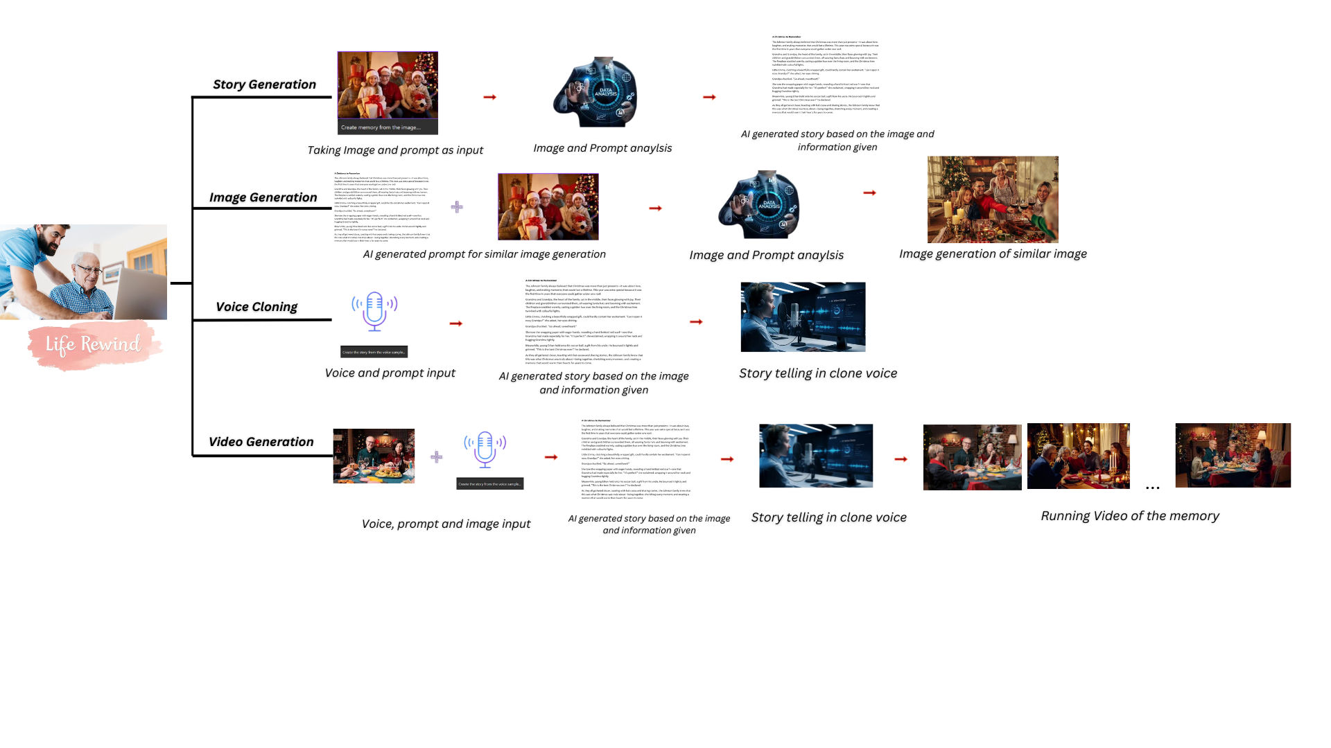
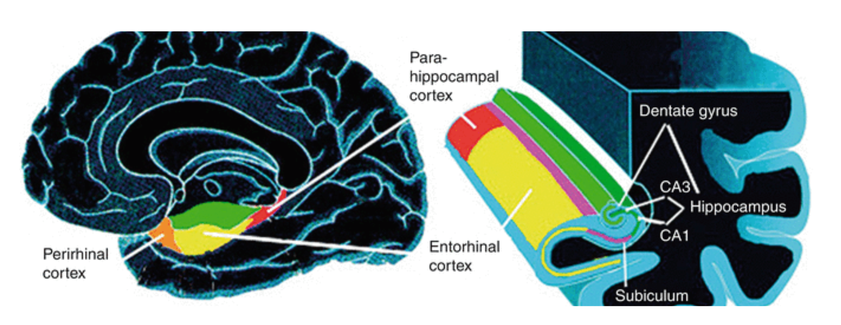
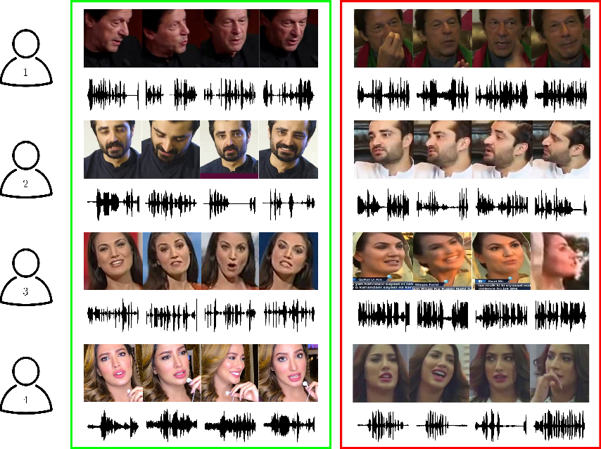
“AI-Driven ‘Life Rewind’ for Alzheimer’s Patients”
MOTIVATION
Alzheimer's disease progressively erases an individual's memories, leading to emotional distress for both patients and caregivers.AI-driven memory reconstruction helps Alzheimer's patients reconnect with their cherished memories, bringing comfort and hope to them and their loved ones. By restoring and narrating life’s precious moments, this project offers a lifeline to fading stories, preserving the bonds that matter most.
Brain Affected Area In Alzheimer Patient
METHODOLOGY
DATASET DETAILS
EXPECTED RESULTS
Frontend Interface: A user-friendly web interface offers four options—story generation, image generation, voice narration, and video generation—allowing users to relive their memories immersively.
Story Generation: An image and text prompt are taken as input. The image is analyzed, and the contextual details are combined with the prompt to generate a meaningful story.
Image Generation: An image and text prompt are taken as input. A story is generated from the prompt, and a new image is created based on the input image and narrative.
Voice Narration: A voice sample and text prompt are taken as input. A story is generated, and voice cloning is performed to deliver the narrative in the familiar voice.
Video Generation: A voice sample, image, and text prompt are taken as input. A story is generated, voice is cloned, and multiple images are created to form a video or slideshow with voiceover.
Backend Integration: Flask connects the Python modules for story, image, voice, and video processing to the frontend, enabling seamless user interaction.
The "Life Rewind" system is expected to help Alzheimer's patients reconnect with cherished memories, enhancing cognitive engagement and emotional well-being. By generating personalized stories, images, voice narrations, and videos, it creates immersive experiences that stimulate memory recall and bring moments of familiarity. The recreation of familiar voices and visuals provides comfort, reducing feelings of isolation and confusion. It also strengthens emotional connections by allowing patients to share memories with loved ones, preserving meaningful relationships. This personalized approach offers therapeutic support, helping patients maintain a sense of identity and continuity. By leveraging advanced AI technologies, the system provides innovative emotional care, improving the quality of life for those affected by memory loss.
DETAILS:
Name: Priyanshu Kumawat - A2305222266, Harsh Upreti - A2305222250
Utkrisht Singh - A2305222225, Divyansh Yadav - A2305222238
Department: BTech CSE
Institute: ASET
Email ID: priyanshu.kumawat@s.amity.edu
User gives voice and images as input
E3G-12B, Amity University, Sector 125, Noida, UP. Email: ai@amity.edu www.amity.edu/acai/

